Slide 1

Crunchy Corner Analysis

Slide 2
PURPOSE
Financial Performance Analysis: This project aims to assess and optimize key financial metrics, including
Net Revenue, EBITDA, and Gross Profit, to drive profitability.
Data-Driven Decision-Making: By utilizing advanced DAX calculations, the project provides insights that
support informed strategic decisions.
Cost Efficiency & Revenue Growth: The analysis helps identify opportunities for improving cost efficiency
and driving revenue growth within the organization.

Slide 3
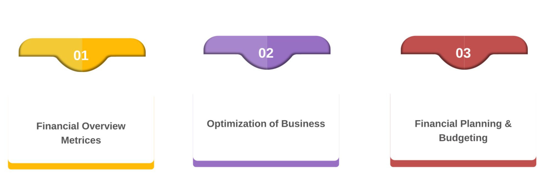
CLIENT REQUIREMENT

Slide 4
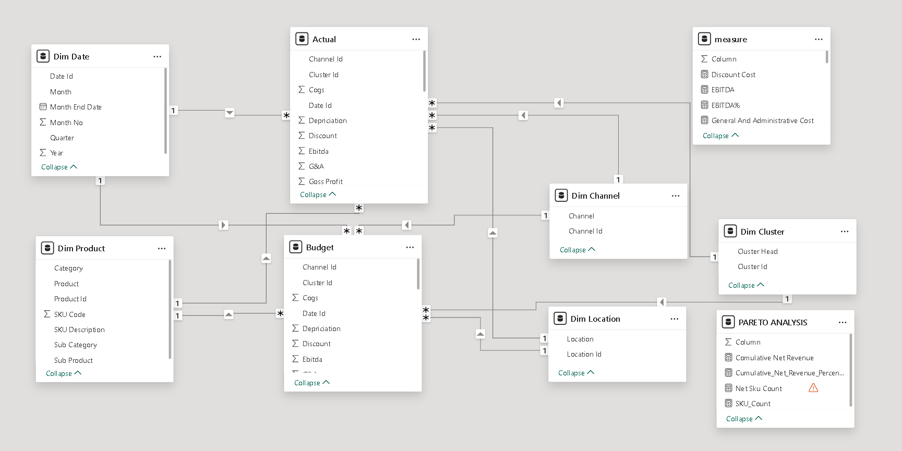
DATA MODEL

Slide 5
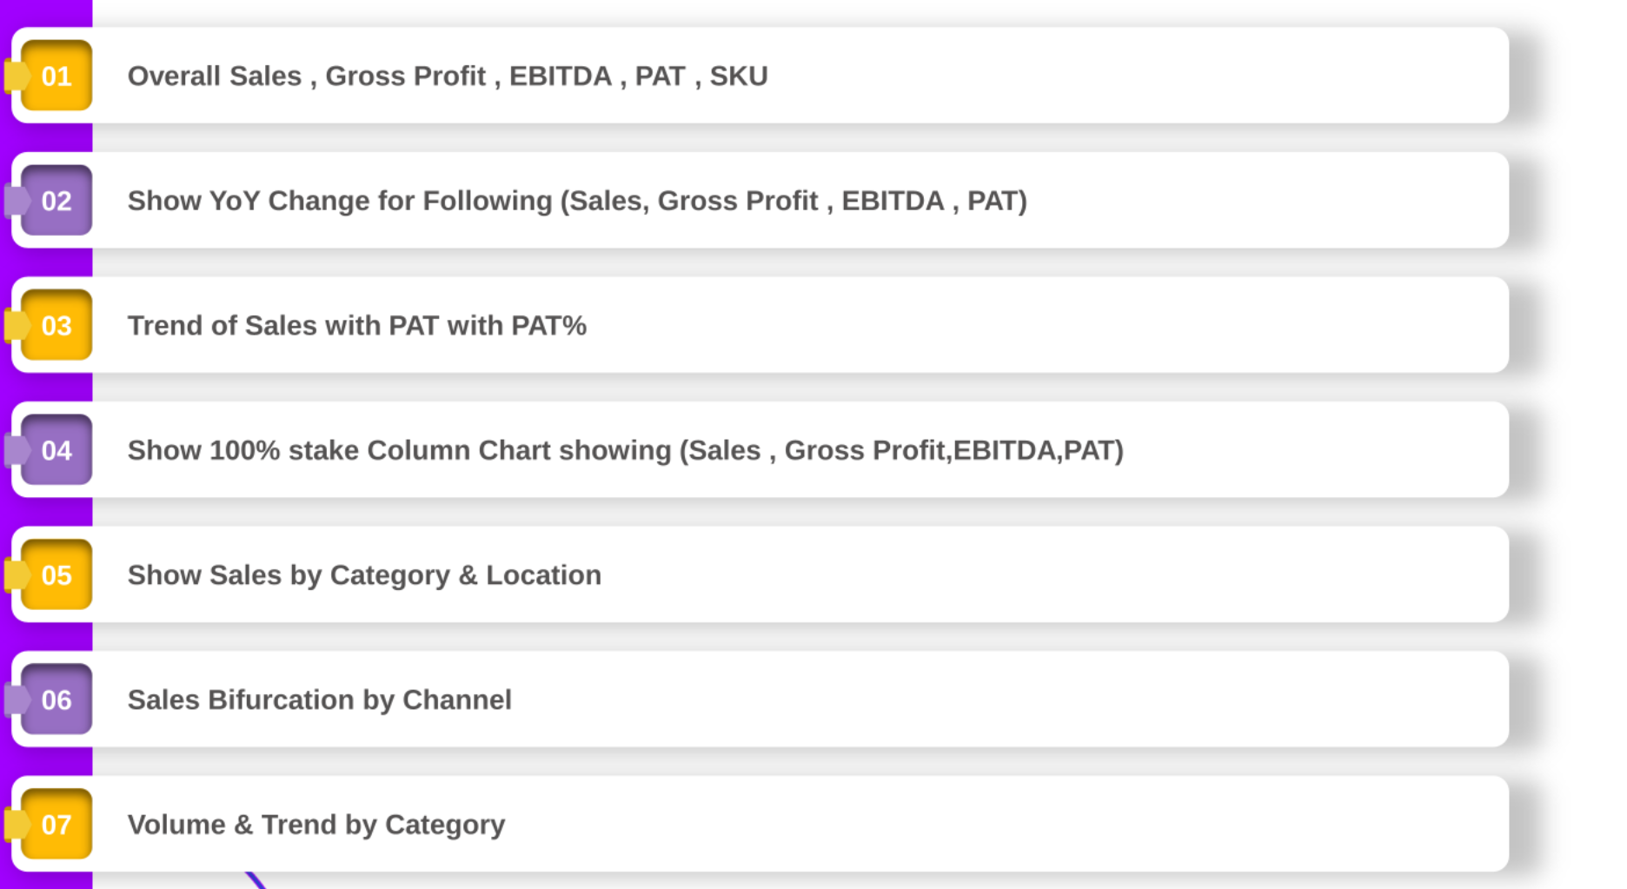
FINANCIAL PERFOMANCE REQUIREMENT

Slide 6

PERFOMANCE ANALYSIS

Slide 7
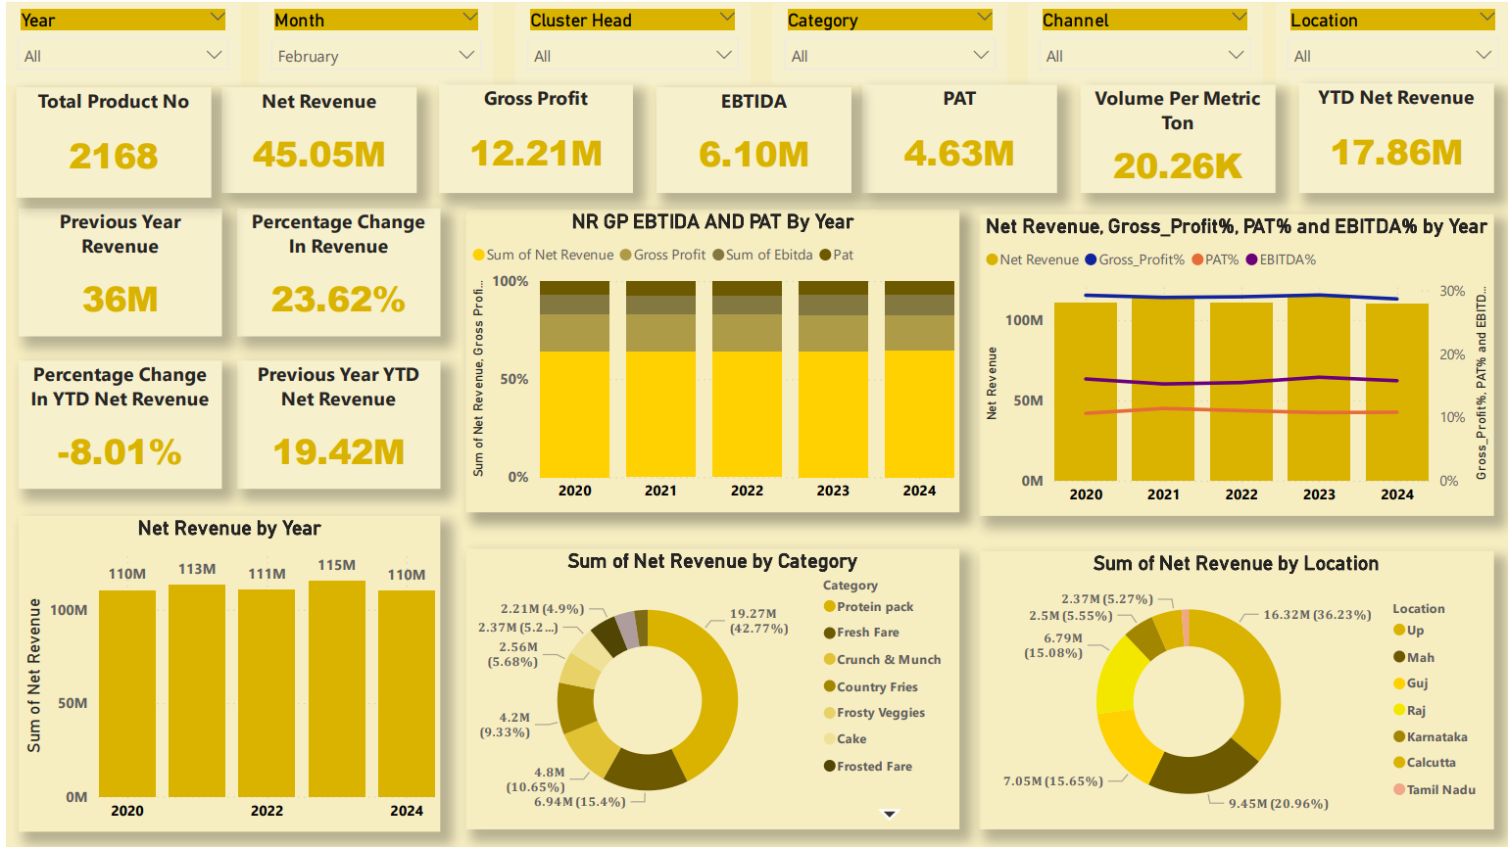

Slide 8
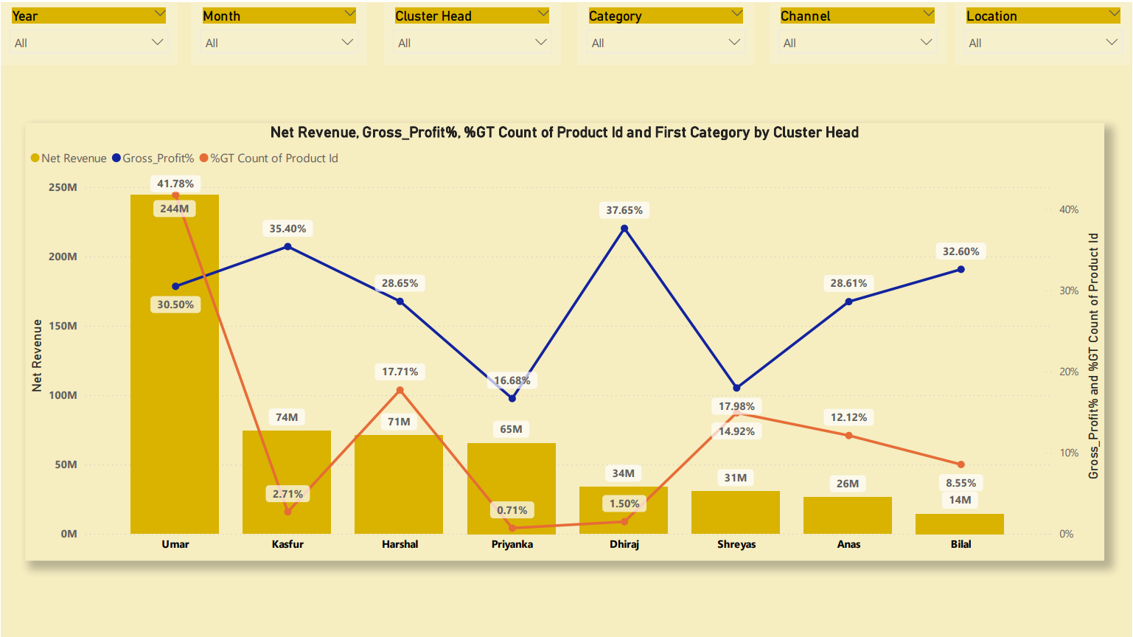

Slide 9

COST ANALYSIS

Slide 10
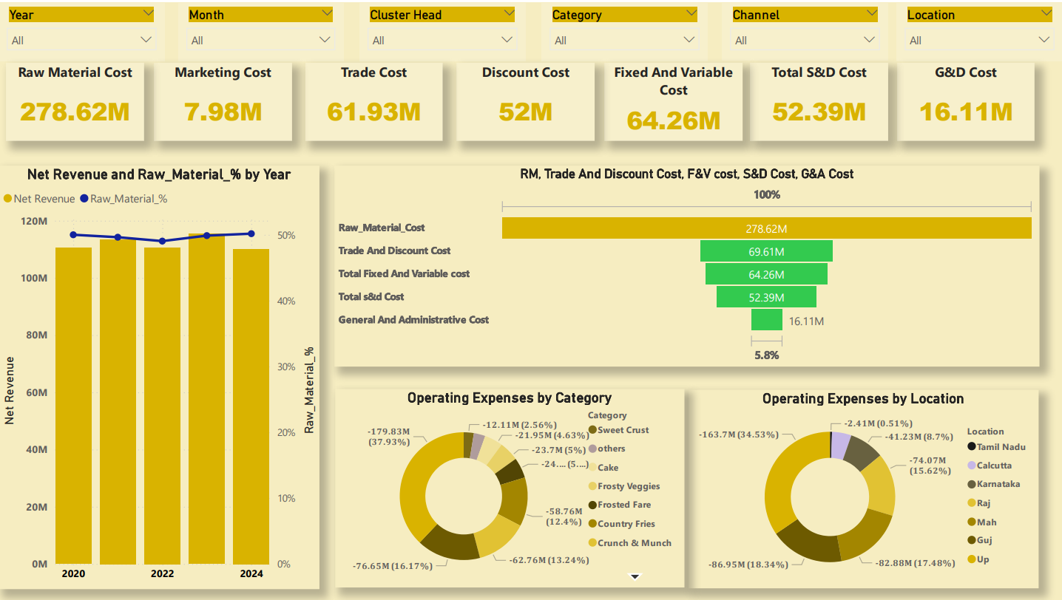

Slide 11
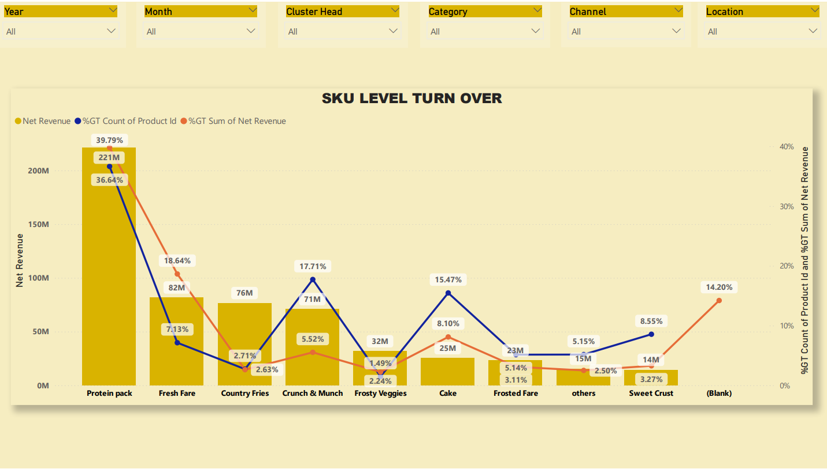

Slide 12
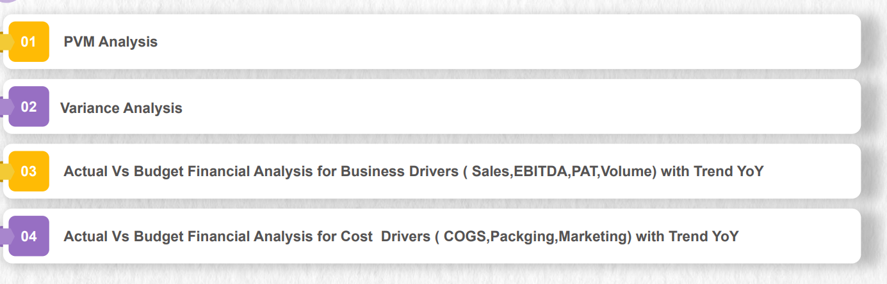
BUDGET ANALYSIS REQUIREMENT

Slide 13

BASIC BUDGETING

Slide 14
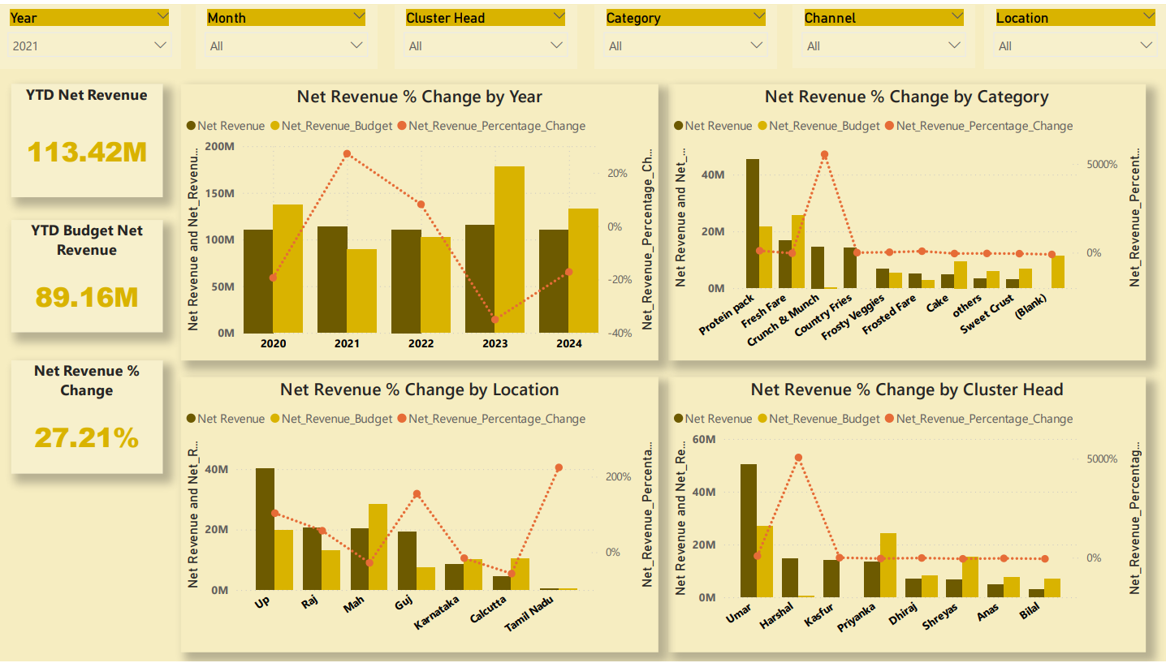

Slide 15

QUADRANT ANALYSIS

Slide 16
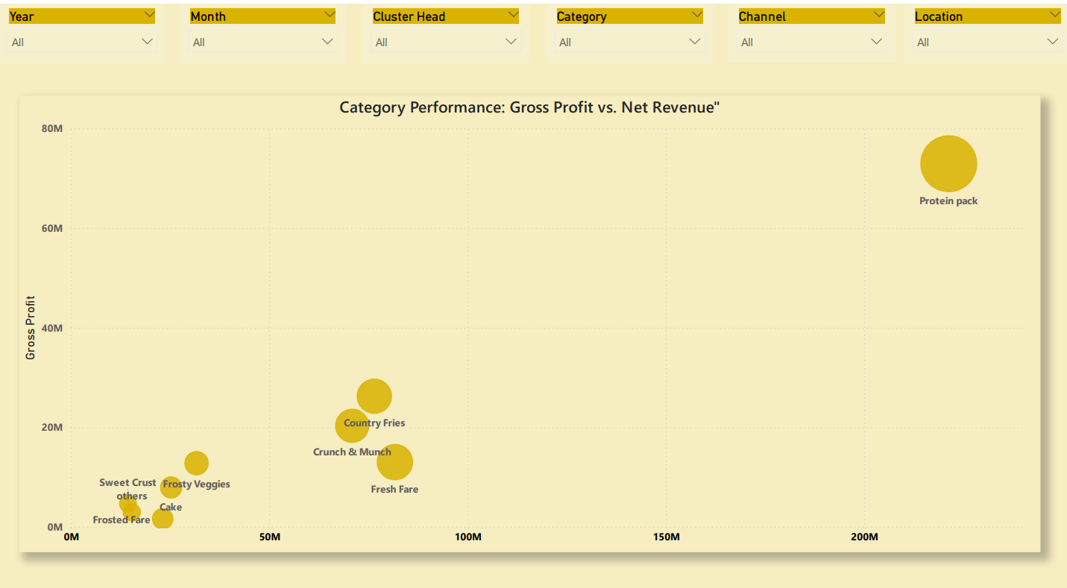

Slide 17
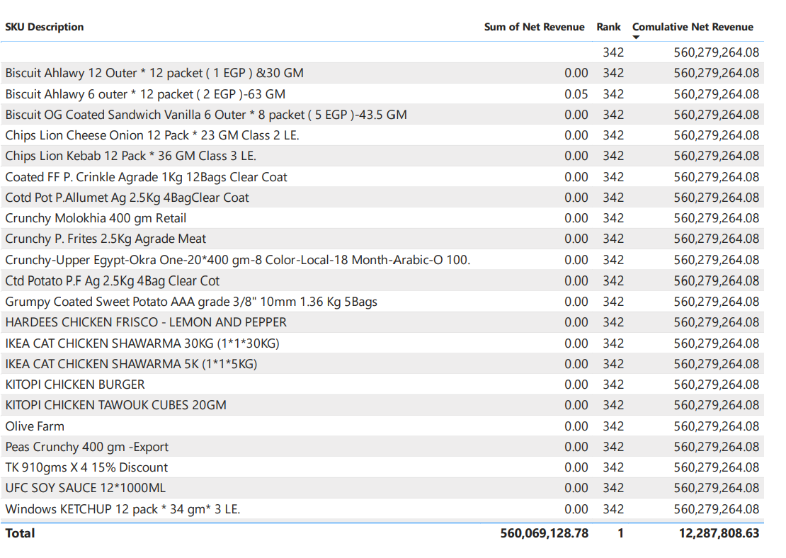

Slide 18

TREE MAP ANALYSIS

Slide 19
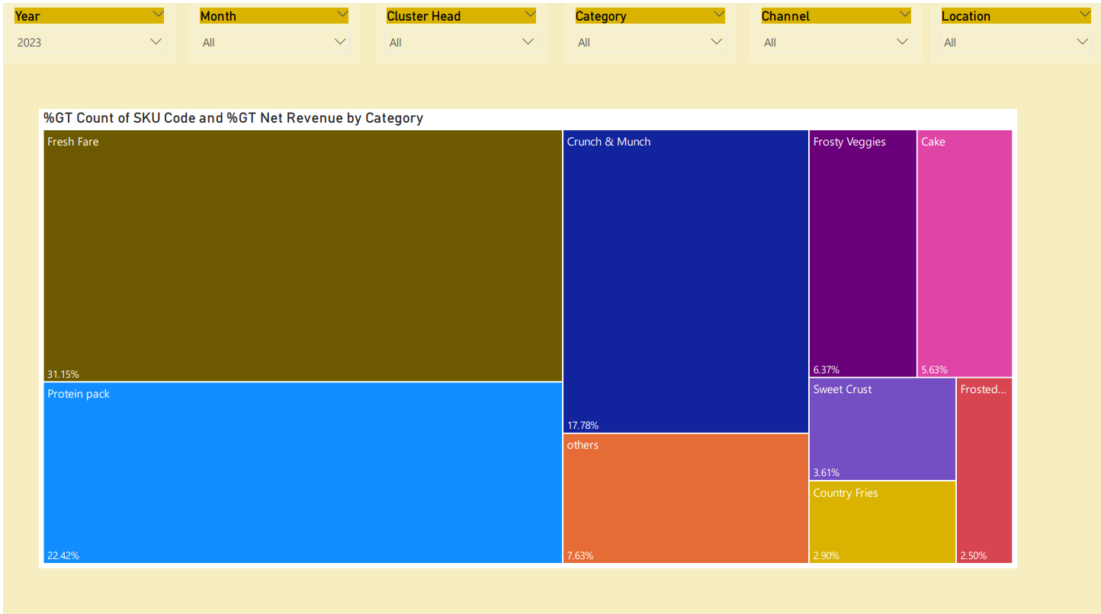

Slide 20


